Slide 1
GAN作業
主講人范竣凱

Slide 2
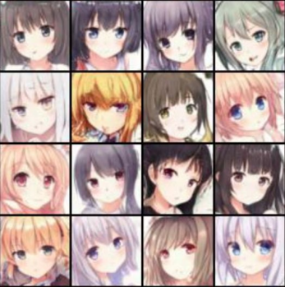
Anime Face Generation
Generator

Slide 3
Evaluation Metrics
FID (Frechet Inception Distance) score
The FID score assesses the similarity between two datasets of images, which is the lower
the better in this task.

Slide 4
Evaluation Metrics
AFD (anime face detection) rate
To detect whether an anime face is in a given image.
The detection rate is the higher the better.

Slide 5
Grading
Simple Baseline
○ FID ≤ 30000 AND AFD ≥ 0.00
Medium Baseline
○ FID ≤ 11800 AND AFD ≥ 0.43
Strong Baseline
○ FID ≤ 9300 AND AFD ≥ 0.53
Boss Baseline
○ FID ≤ 8200 AND AFD ≥ 0.68

Slide 6
Baseline Guide
Simple
Random submission
Medium
DCGAN + WGAN
2~6 hr
Strong
DCGAN + SNGAN
2~6 hr
Boss
AutoGAN, BigGAN, Progressive GAN, Self-Attention GAN, StyleGAN, StyleGAN2
6~16 hr

Slide 7
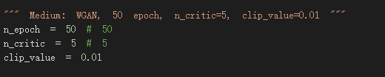

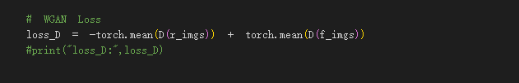
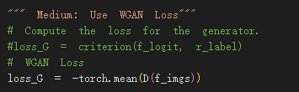
Medium Baseline(WGAN)

Slide 8
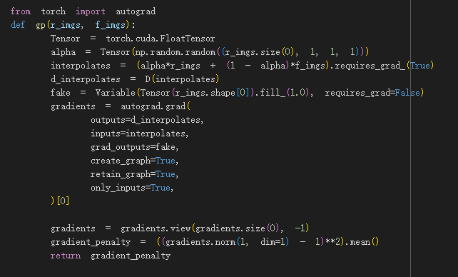
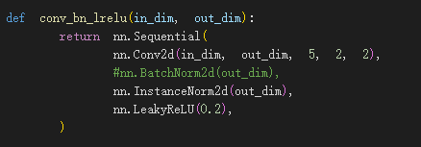

WGAN-GP

Slide 9
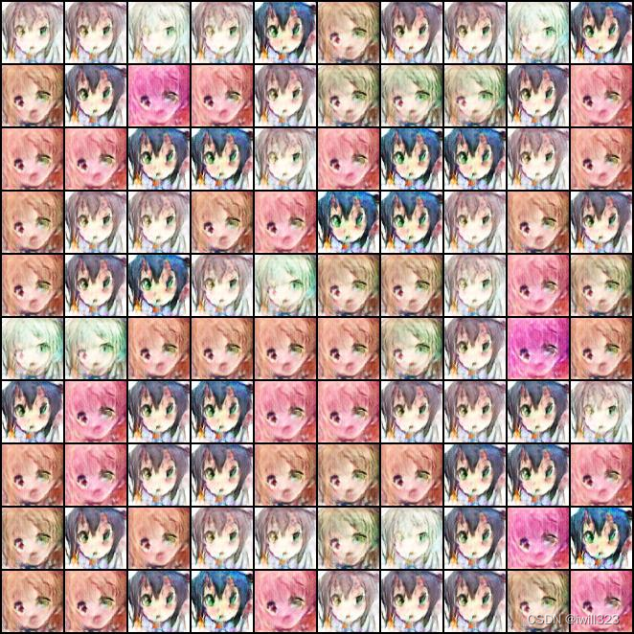
發現的問題

